Slide 1
Serial Communication with UART
with
Dapo Sosangu

Slide 2
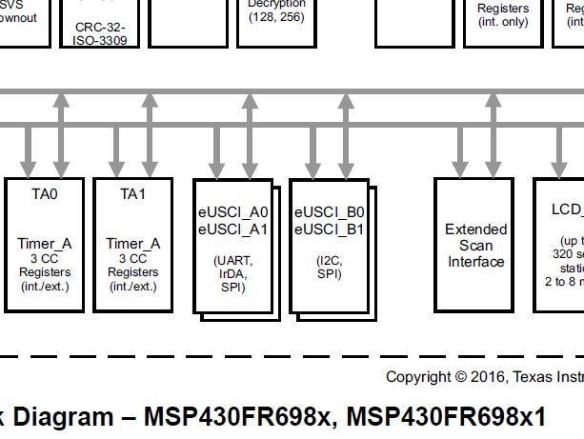
About eUSCI_A0, eUSCI_A1…eUSCI_Ax
Things to Know about eUSCI Module
1) UART only available on eUSCI_A0 and eUSCI_A1.
2) eUSCI_A0 & eUSCI_A1 implies the chip has two UARTs.
3) Connection for eUSCI_A0 are UCA0RXD ( port4.3/pin1) &
UCA0TXD (port4.2/pin100). The signal can also be routed out from port2.1/pin50 (RXD) and port2.0/pin51 (TXD).
4) Connection for eUSCI_A1 are UCA1RXD (port5.5/pin88) & UCA1TXD (port5.4/pin87).
5) Both UARTs are configured in the same way.
Page 9 of datasheet has the chip block diagram

Slide 3
So What’s Special about this Chip’s UART?
Turn auto baud rate detection on or off
You can set an idle time between blocks of data during RX/TX
Auto-idle when no RX/TX data.
Power the UARTs with separate clocks.
Notes:
Features favour low power operation.

Slide 4
How to Configure the UARTs
Configuring the UART is pretty much the same as any other microcontroller if you’re not enabling some chip specific features of the
Set clock
Set baud rate
Set ISR
Notes:
Chip specific features: irDA encoding and decoding, setting idle time between blocks of data transmitted, etc. There were some other stuff in the datasheet that looked too complicated to bother about.

Slide 5
Time to Code…
Open up the UART project on the IDE and let’s walk through the code.
Our code will toggle the LED if it detects an ‘r’ or ‘g’ via UART.
Can you remember how to make the connection from the USB-UART device and the board yourself? And which pin to use?
#pragma vector=USCI_A0_VECTOR
__interrupt void USCI_A0_ISR_modem(void)
This is how we write interrupts. Keep the format handy, just like we used the watchdog timer.

Slide 6
THE END

